Slide 1

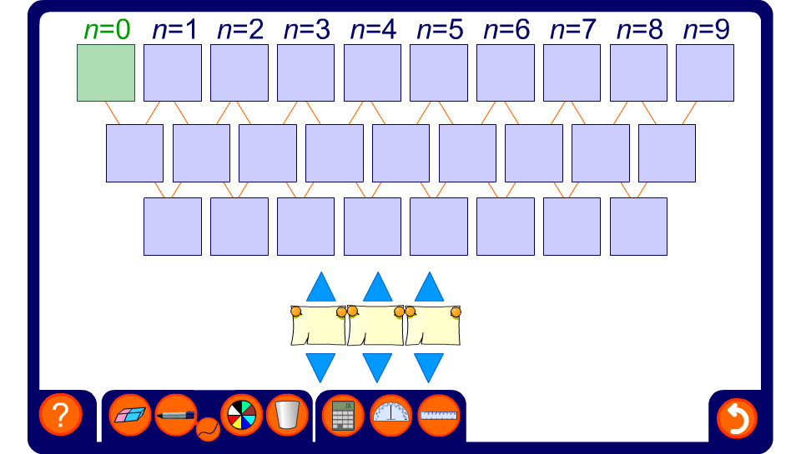


Finding the n^{th} term of a quadratic sequence
Notes:
Use this activity to randomly generate quadratic sequences by clicking on the blue arrows.
Reveal the first five terms in the sequence and ask pupils how we can proceed using differences and the value of the 0th term to find the formula for the n^{th} term.

